Slide 1
ITSC 203:
Offensive and Defensive Tool Construction
Immunity Debugger Introduction Taxonomy
Notes:
1

Slide 2
Immunity Debugger
Immunity is a commercial grade debugger used for software development.
It's roots are tied to the Olly Debugger which is an open source tool developed by Oleh Yuschuk.
Immunity licensed the Olly Debugger code base and expanded upon it adding python as a script development module. This allows the tool a great deal of flexibility to automate many reverse engineering activities that would otherwise be manual.

Slide 3
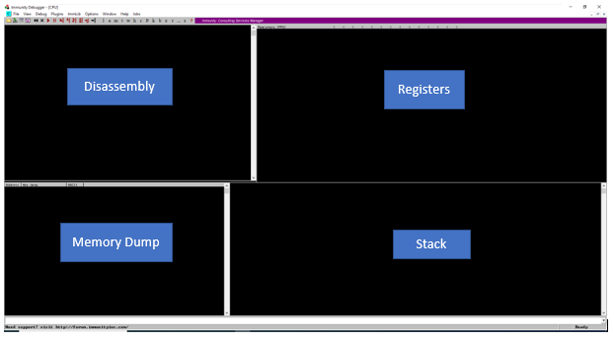
Immunity Debugger
Launching Immunity brings up the following interface that allows the user access to many features of the tool. You can download Immunity from the following website: http://debugger.immunityinc.com
Some user information is required:
Installation is straightforward and the setup can be completed quite quickly. On first launch the window appears as shown below:

Slide 4
Window Area
Immunity has a few areas of interest when you first launch the program:
Menu
File (open or attach) to a process
Debug (step in, out, over) commands
Other debug features to be discussed
2. Windows
Disassembly (Assembly code shown alongside, opcodes, and addresses
Registers (Show the status of each register synchronously)
Memory Dump (Can show any region of memory in hex and ascii format)
Stack (shows address, hexadecimal and ascii values)
3. Command (PyCommand area)
4. Status/Info bar

Slide 5
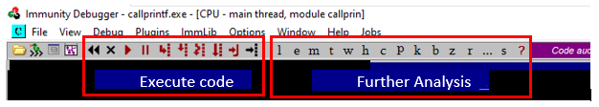
Command Shortcuts
To assist with rapid debugging Immunity has a shortcut bar which has commands that are often used during analysis. The image below highlights some of those links.
There's a debugger section so that the analyst can step out, into, over etc of code. The Further analysis shortcuts allow for views of memory, access to loaded modules (libraries), breakpoints and many more features

Slide 6
Initial start-up
Launch the program to see the interface as shown on slide 3.
After launching, there are 2 options to begin analysis; open or attach.
Open a process shows a screen to the one shown below. The debugger stops the program prior to any user code being executed. This bit of code is related to setting up the environment for the application to run properly.
Selecting the button the code runs to user code and stops.
At this point the user can then perform some initial analysis.
The point at which the user code begins is referred to as the Entry Point. As in the Entry point to the user code.
Is there another way to get this address? Are there other tools that can help with determining the Entry Point?

Slide 7
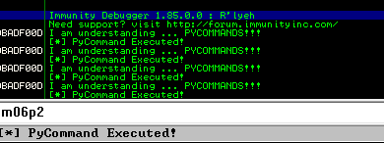
PyCommands
PyCommands
Prerequisites:
Must have main. main takes 1 argument, ( a list of arguments)
Must return a message to be displayed on the status bar at the bottom.
Execute it by running !<name of script> "NO EXTENSION"
Status messages in status bar for PyCommands
Log messages
Debugging status (Ready, Terminated, Running etc)

Slide 8
PyCommands
PyCommands are python scripts that allow the analyst the ability to automate the debugging/analysis process.
The free Immunity Debugger has not updated to use the latest version of python. So when you install Immunity you will be stuck with using the python2 interpreter. There a few subtle differences, but overall the guts of the interpreter operates similarly to python3.
Differences include you having to use print "Python3" instead of the print("Python3") …
Despite using python, there are a few other quirks you will need to observe when building your code.
PAY ATTENTION TO YOUR SPACING ( and TAB) … IT IS UNFORGIVING!!!

Slide 9
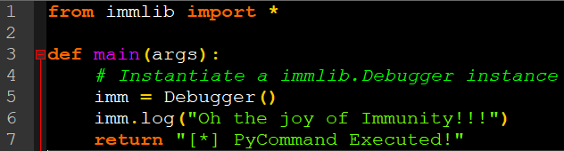
First PyCommands
Example pyCommand and what it does is show below:
Line 1: import the module that contains the Debugger class
Line 3: Define a main function. (This is required including the parameter args)
Line 5: Instantiate a Debugger object called imm ( you can call it anything
you like).
Line 6: Access the log window with immunity and print a line in it
Line 7: Required return of a string that will be printed in the status bar.
Do not use print in your PyCommands!!!! log is the alternative

Slide 10
PyCommands
The code in the book has been known to have different spellings for function names. If you are finding yourself getting lots of errors as you build your automation scripts check the following file:
C:\Program Files\Immunity Inc\Immunity Debugger\Libs\immlib
There are other libraries or modules in the same directory worth investigating on your own.
Please be aware that the help files are not particularly useful. Nevertheless, the contents of the modules are sufficiently commented. The modules are also well formatted and you will be able to make inferences as you work through them.

Slide 11
Shell Code
Converting the C code to shellcode, will be covered in the next lecture. How do we accomplish this? … !!!
More to come …
http://www.mingw.org/wiki/Getting_Started

